Slide 1
GitHub Introduction
Introduction to GitHub for Eli Lilly – Azure POCs
Firenze, 13th January 2022

Slide 2
Agenda
Git and GitHub
Configure SSH Keys in GitHub
Create a new remote repository
Feature Branch workflow
Operations on remote repositories
Work with branches and multiple remotes
Merges and conflicts resolution
Best Practices

Slide 3
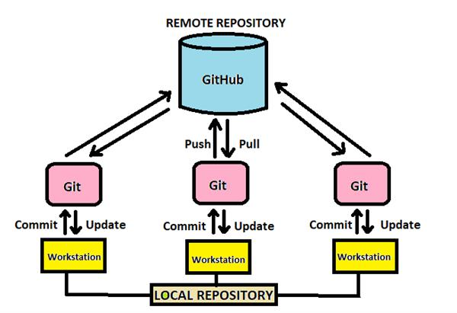
Git and GitHub
Are jointly used by developers to share code and keep track of changes.
Git
GitHub
software
version control system
installed locally
command line tool
service
hosting service for repositories
user interface
hosted in cloud
https://docs.microsoft.com/en-us/learn/modules/introduction-to-github/2-what-is-github

Slide 4
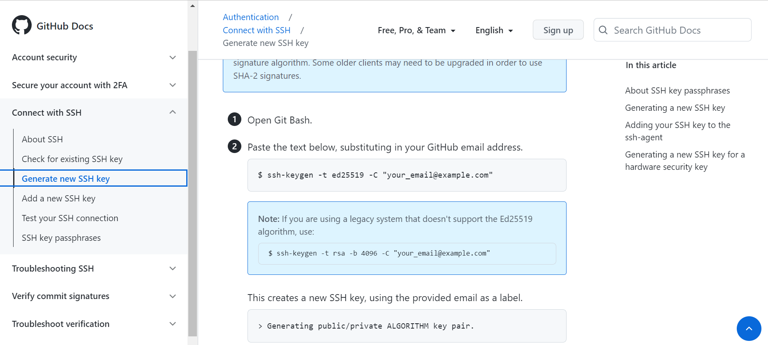
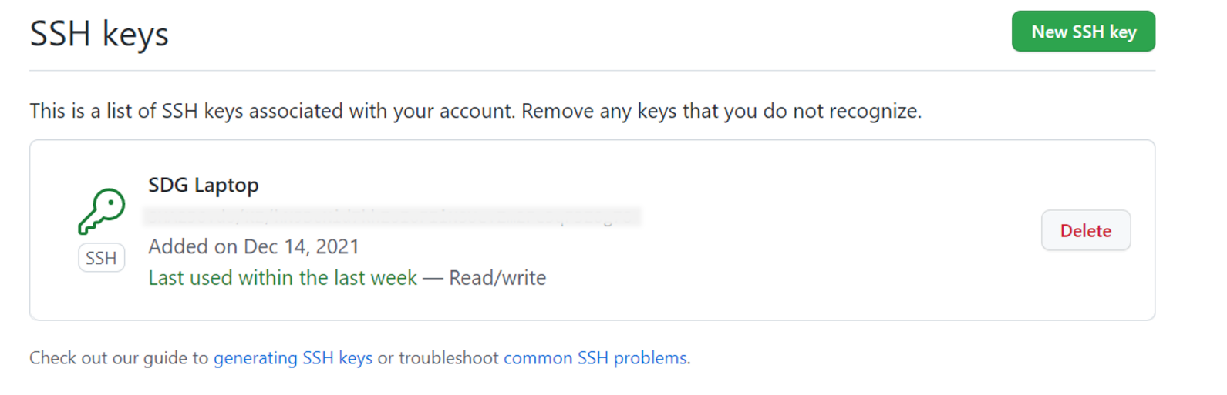
Use Git and GitHub
Download and install Git on local machine (https://git-scm.com/downloads)
Generate a new SSH Key on your PC using the following command: “ssh-keygen -t ed25519 -C "your_email@example.com"
Add a new SSH Key to you GitHub personal account, to authenticate and authorize laptop to perform pull/push operations:
Open command line and type ssh-keygen
Find public/private keys in folder C:\Users\{username}\.ssh
Go to GitHub account > Settings > SSH and GPG keys
Select New SSH key
Copy and paste the content of the public key (green file with extension .pub)
Check also the GitHUB page: ( About SSH - GitHub Docs )

Slide 5
Create a new remote repository
New remote repositories can be created from your personal profile, in Repositories section
Locally, from Git command line, you move inside the folder where your code resides and execute the following commands:
git init
git add .
git commit –m “comment to commit operation”
git branch –M main
git remote add origin git@github.com:carolina-becatti-sdg/test_repo.git
git push -u origin main

Slide 6
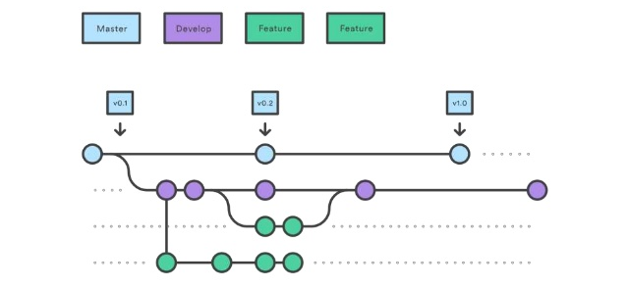
Feature Branch workflow
https://medium.com/techwasti/git-workflow-44b4d08e2c83

Slide 7
Operations on remote repositories
To clone an existing remote repository
git clone add git@github.com:carolina-becatti-sdg/test_repo.git
To push new developments to remote repository on main branch (change the branch name to push to a different branch)
git status
git add .
git commit –m “comment to commit operation”
git push –u origin main
To update local repository with new code from remote repository on main branch (change the branch name to pull from a different branch)
git pull –u origin main

Slide 8
Work with branches and multiple remotes
To create a new local branch with name feature_branch
git checkout –b feature_branch
If you want to create a local branch that tracks an existing remote branch with name feature_branch. Origin is the first remote added to the project (used as default).
git checkout –-track origin/feature_branch
To list all remotes added to the project
git remote -v
To add a new remote to the project. Since origin is the default remote, the new one is called remote_name. Remote path is something like git@github.com:carolina-becatti-sdg/test_repo.git
git remote add remote_name remote_path

Slide 9
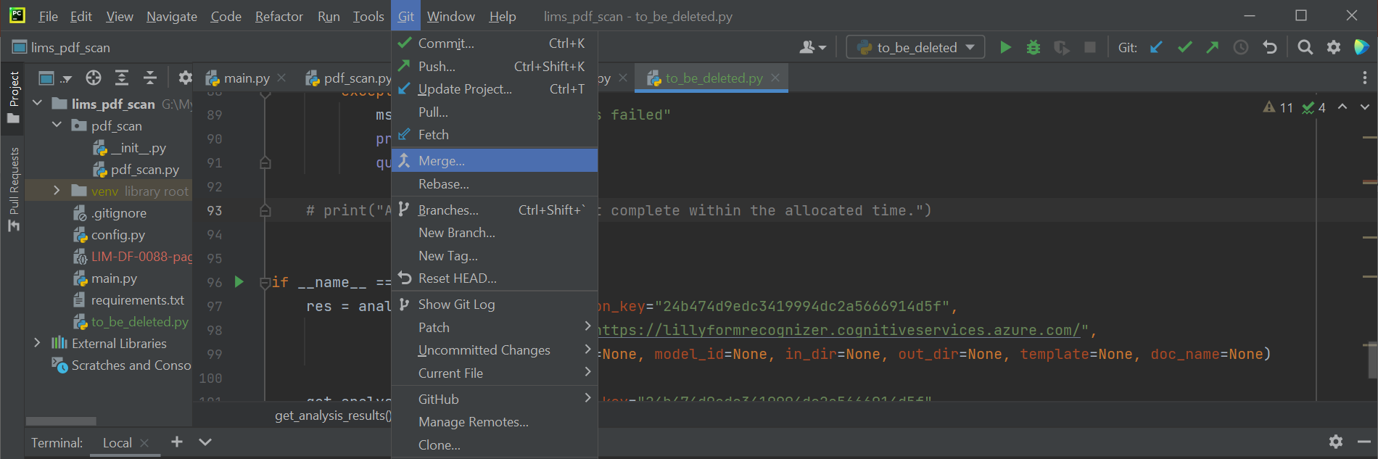
Merges and conflicts resolution
In case two developers work on the same part of the code, a push operation may return an error message (a conflict)
This happens because the latest push operation would overwrite previous lines of code
Git simply highlights the impacted code and waits for manual resolution, meaning that we have to decide which part of the code need to be updated

Slide 10
Best Practices
Use meaningful branches
Use meaningful commit comments
Do not commit and push configuration files
Delete merged branches
Commit and push a requirements file with installed packaged and their versions, it’s easier for other developers to reproduce the same working environment.
Always include a .gitignore file. This file should contain:
system directories (settings, preferences, etc)
virtual environment folders
dependencies (if any)
Many IDE provide gitignore templates ready to use.

